Slide 1

SHARE BIKE REDISTRIBUTION
HAOYUAN SONG;
MINGRUI YIN

Slide 2

CONTENTS
PART 1 INTRODUCTION
PART 2 DATA ANALYSIS
PART 3 NETWORK ANALYSIS
PART 4 CONCLUSION

Slide 3
PART
ONE

Slide 4
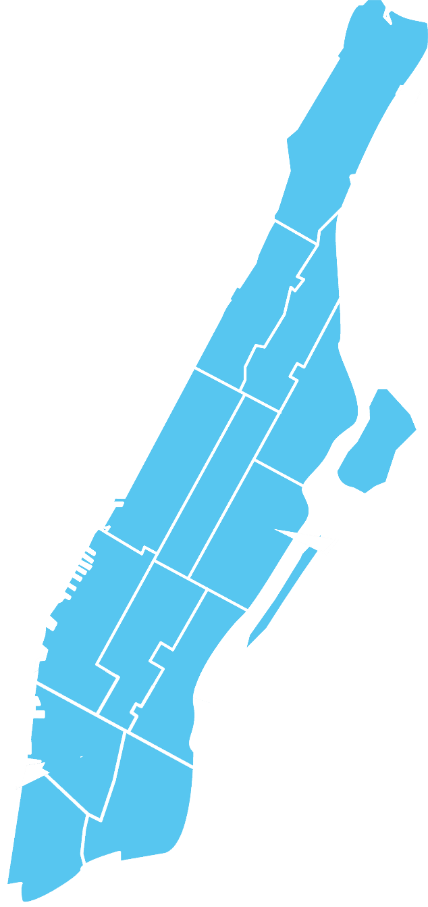
SHARE BIKE REDISTRIBUTION
INTRODUCTION
Citi Bike is New York City’s bike share system. The bikes can be unlocked from one station and returned to any other station in the system, making them ideal for one-way trips. People use bike share to commute to work or school, run errands, get to appointments or social engagements, and more.

Slide 5
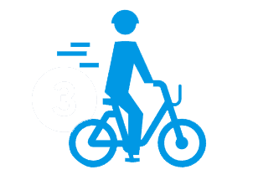


SHARE BIKE REDISTRIBUTION
INTRODUCTION
A
B
C
UNLOCK
RIDE
RETURN

Slide 6
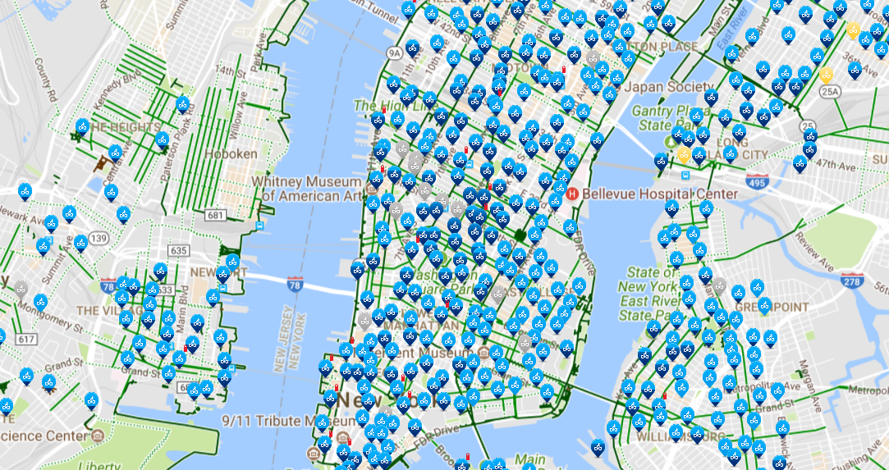
SHARE BIKE REDISTRIBUTION
INTRODUCTION

Slide 7
PART
TWO

Slide 8

SHARE BIKE REDISTRIBUTION
DATA ANALYSIS
Data Cleaning
Training the Model
Prediction

Slide 9
SHARE BIKE REDISTRIBUTION
Data Cleaning
Trip Duration (seconds)
Start Time and Date
Stop Time and Date
Start Station Name
End Station Name
Station ID
Station Lat/Long
Bike ID
User Type
Gender
Year of Birth
Station Name
Station ID
Load Per-Hour
Station Longitude
Station Latitude

Slide 10
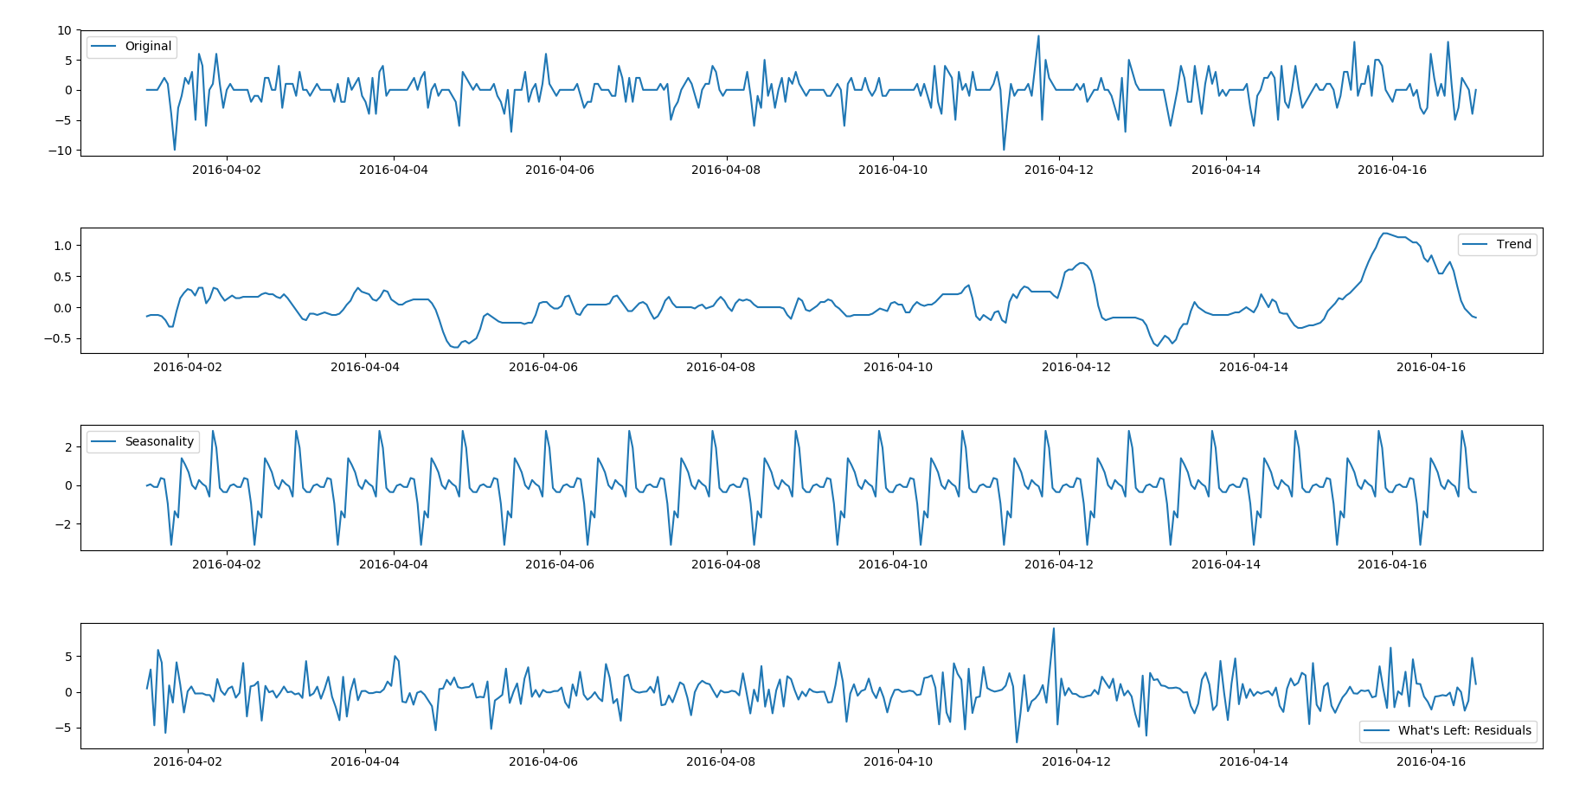
SHARE BIKE REDISTRIBUTION
Training the Model

Slide 11
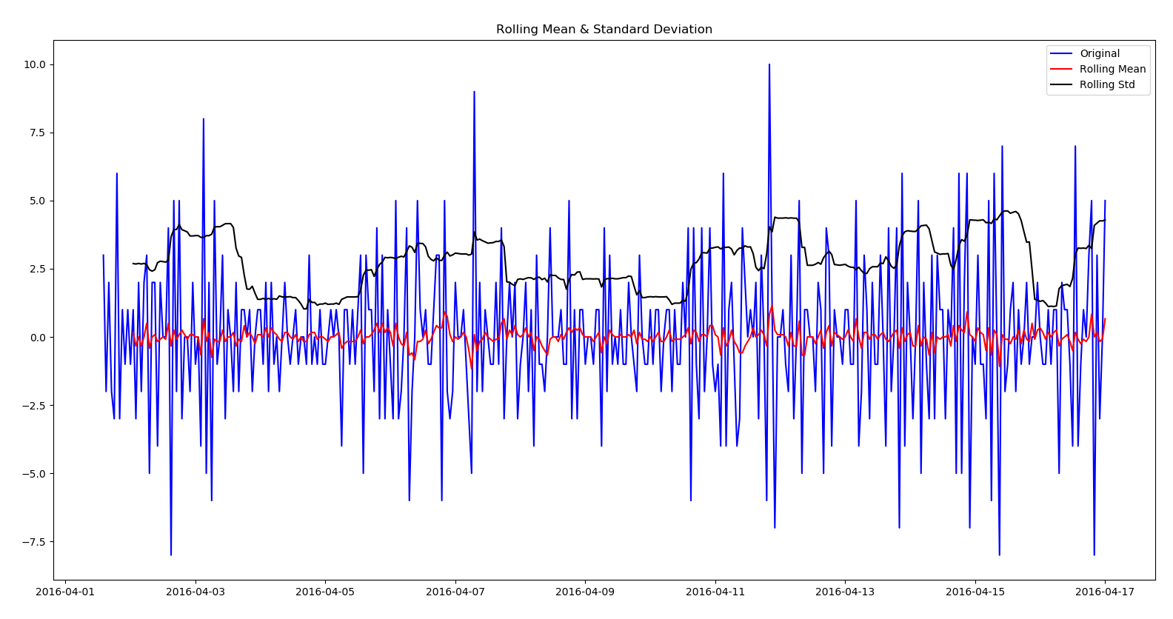
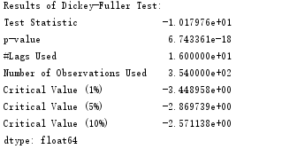
SHARE BIKE REDISTRIBUTION
Training the Model

Slide 12
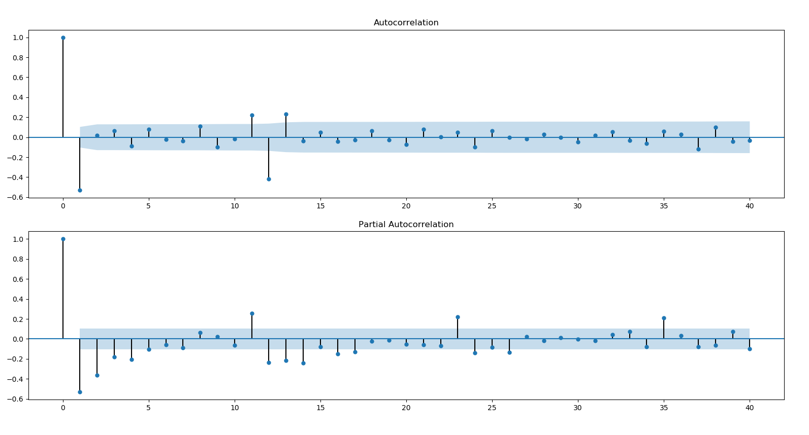
SHARE BIKE REDISTRIBUTION
Training the Model

Slide 13
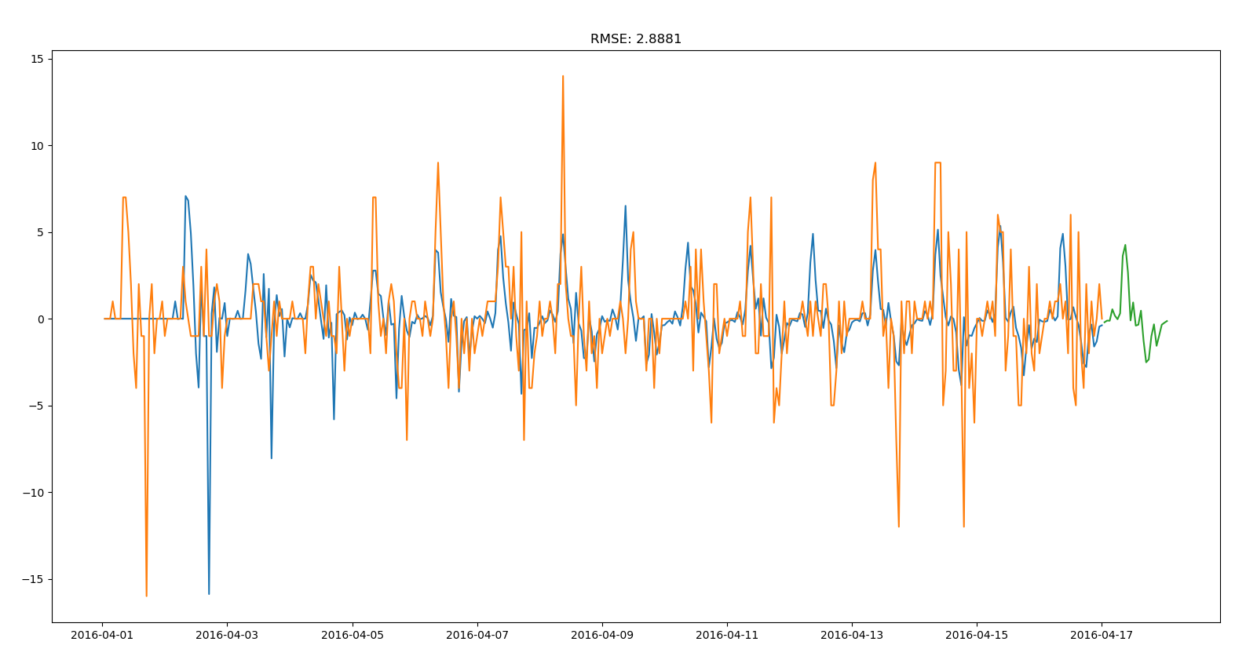
SHARE BIKE REDISTRIBUTION
Training the Model
mod = sm.tsa.statespace.SARIMAX(df.riders, trend='n', order=(0,1,0), seasonal_order=(1,1,1,12))

Slide 14
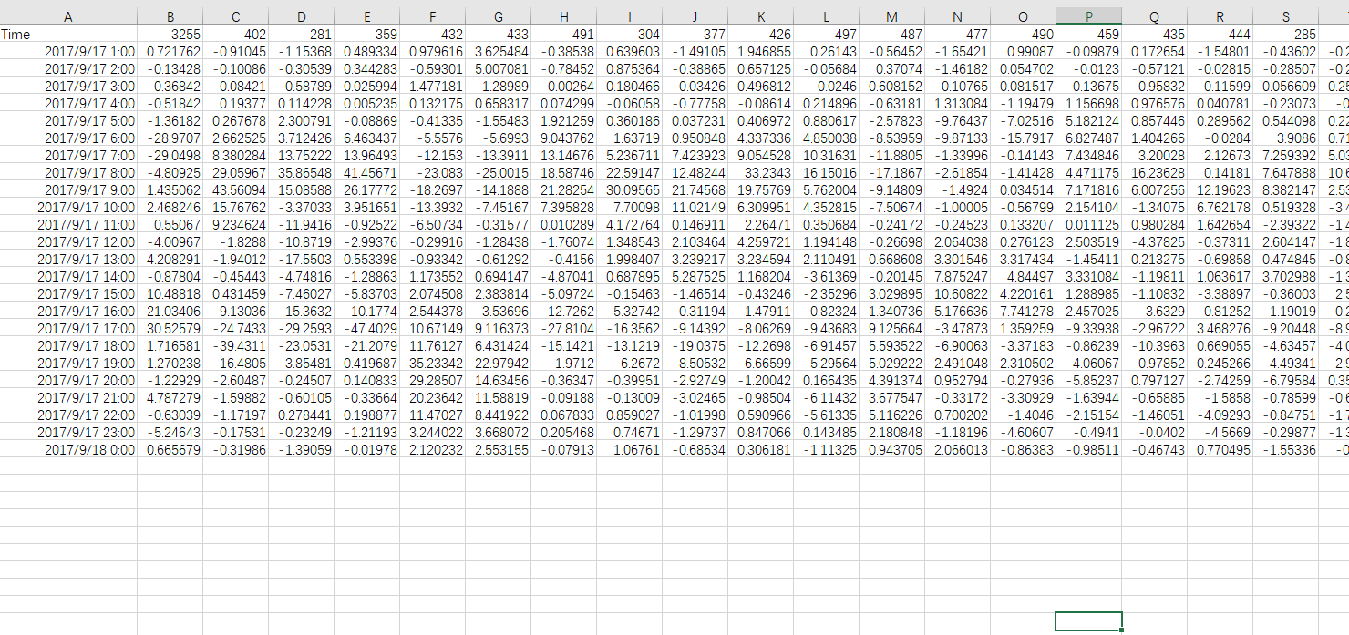
SHARE BIKE REDISTRIBUTION
Prediction
Time series data by station Id

Slide 15
PART
THREE

Slide 16
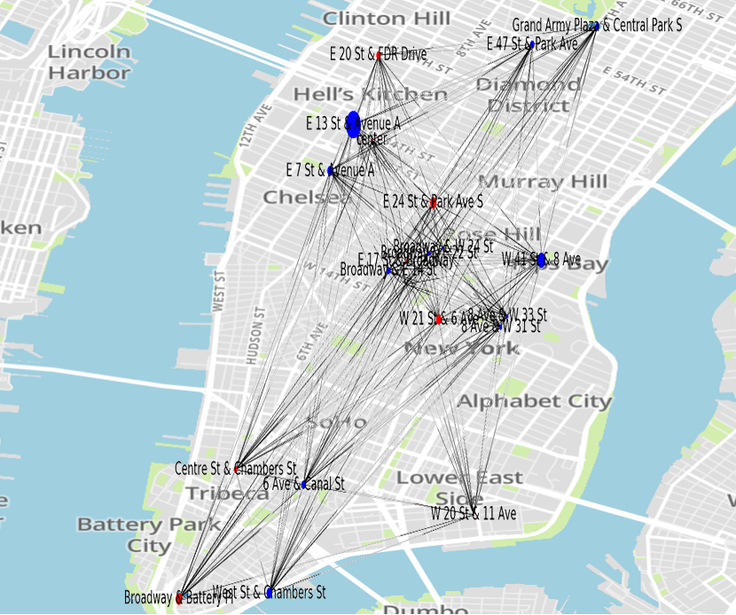
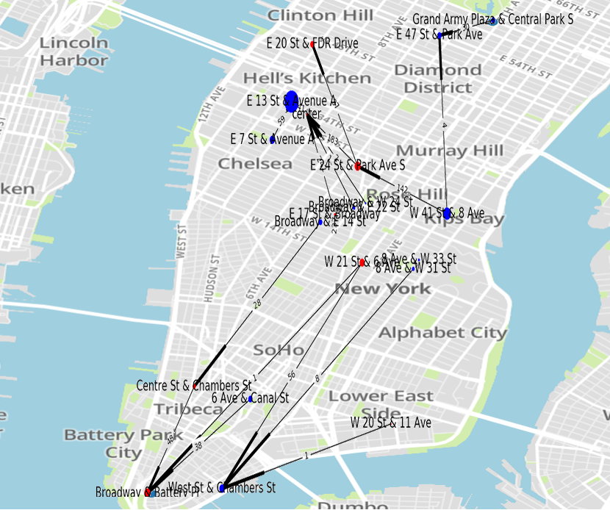
SHARE BIKE REDISTRIBUTION
NETWORK ANALYSIS

Slide 17
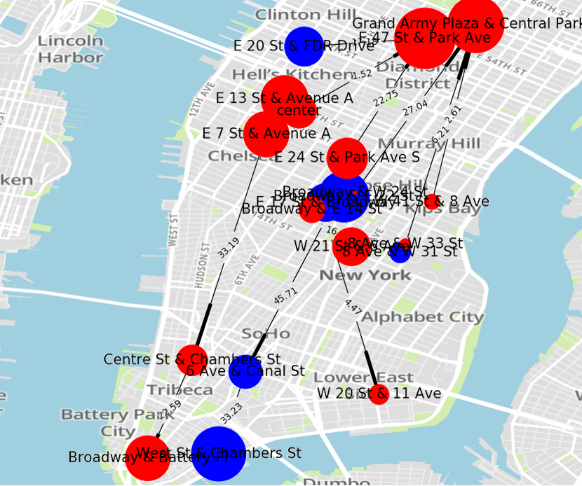
SHARE BIKE REDISTRIBUTION
NETWORK ANALYSIS

Slide 18
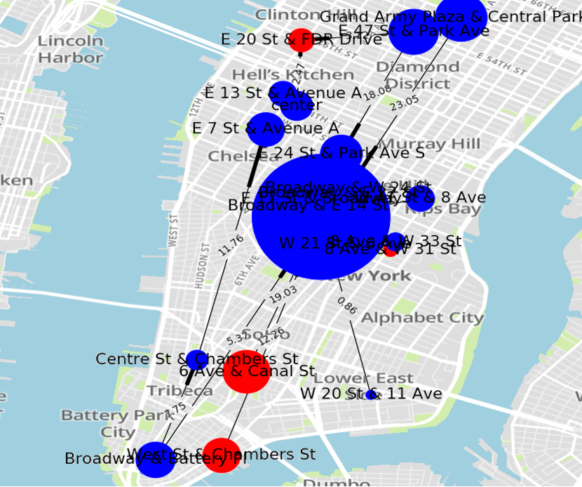
SHARE BIKE REDISTRIBUTION
NETWORK ANALYSIS

Slide 19
PART
FOUR

Slide 20
DATA
ANALYSIS
SHARE BIKE REDISTRIBUTION
NETWORK ANALYSIS
CONCLUSION
FUTURE WORK

Slide 21
THANKS

